Slide 1
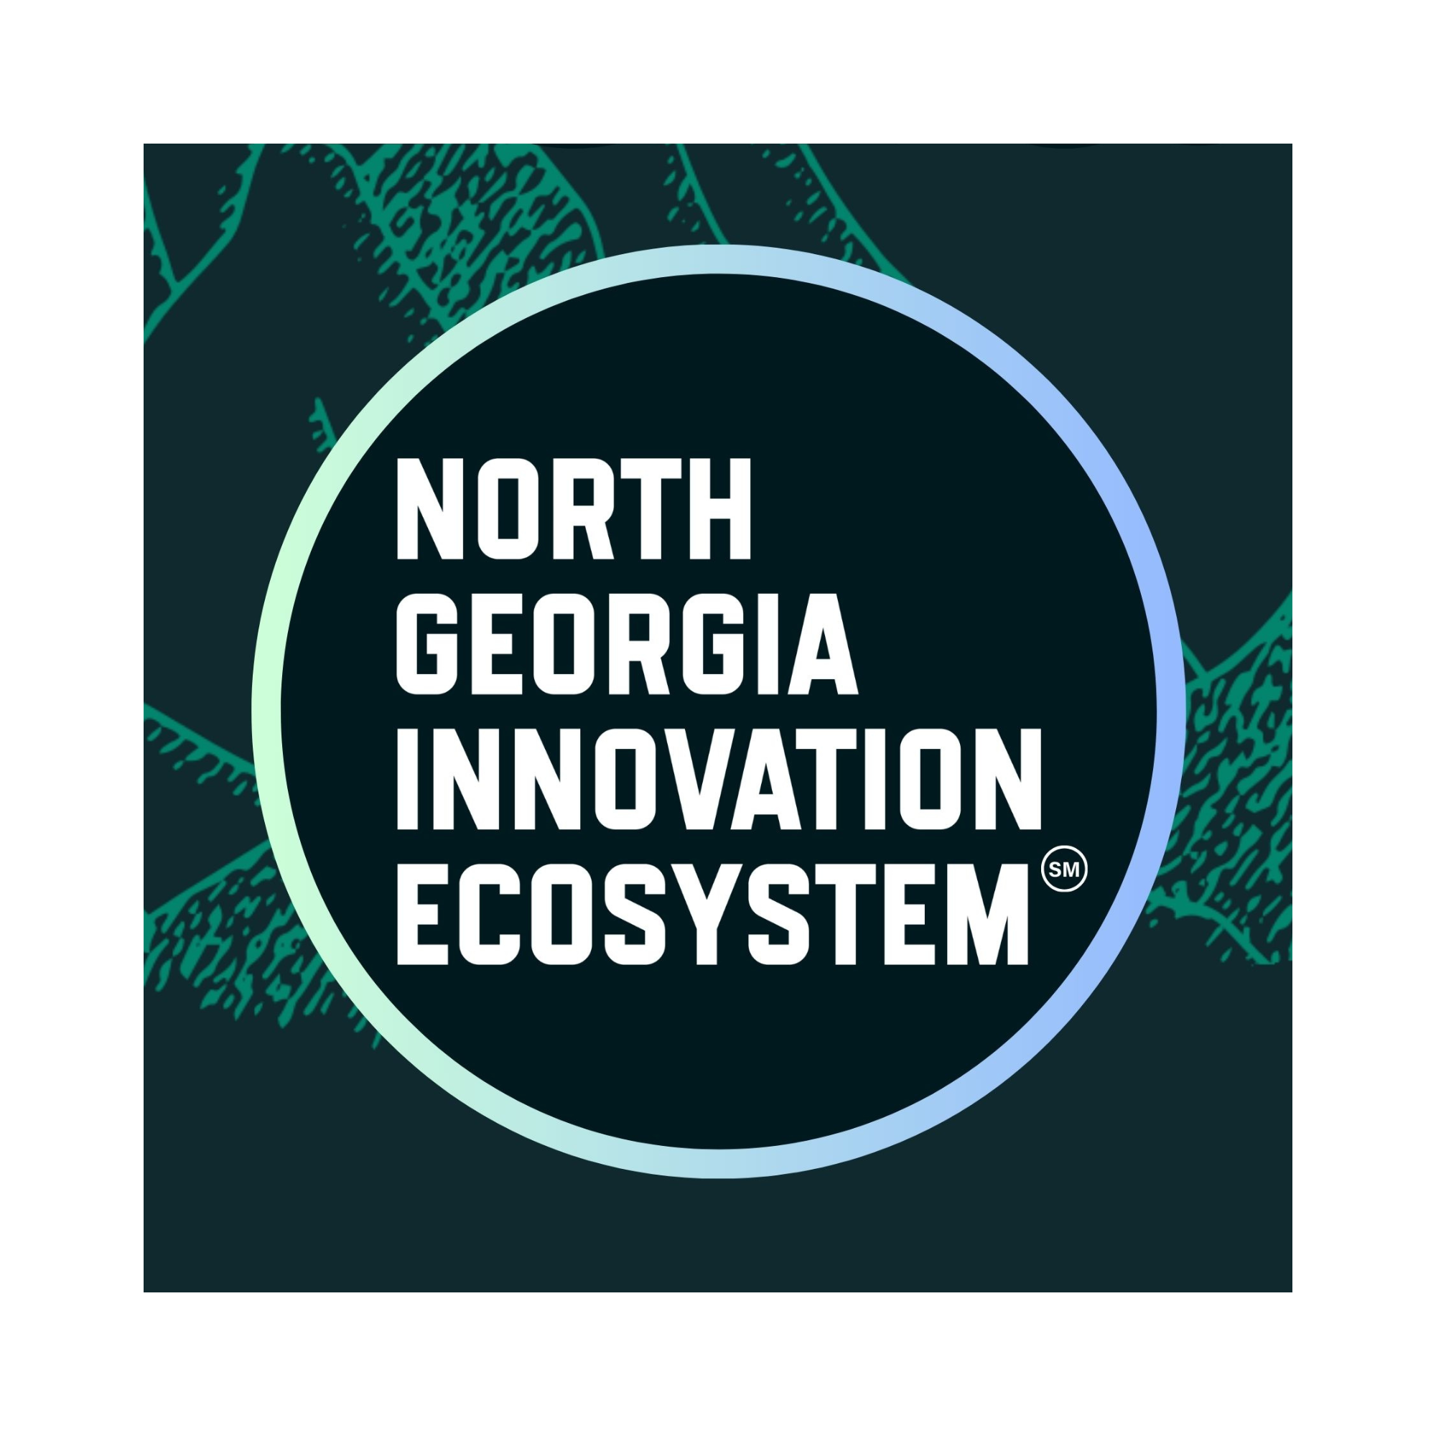
NGIE-AI Platform Architecture
A client-ready business knowledge platform for promoting ecosystem domains, packaging services, and generating growth assessments.
DEMO PRESENTATION
NO AI API DEPENDENCY
Built for North Georgia Innovation Ecosystem

Slide 2
THE CLIENT OPPORTUNITY
Local businesses need a clearer path to growth
NGIE-AI turns scattered websites, tools, ideas, and customer interactions into a structured business growth conversation.
Confusing vendor market
Disconnected local knowledge
Assessment-led sales
Business owners hear about websites, SEO, automation, AI, CRM, ecommerce, and training, but rarely get a practical roadmap.
Your ecosystem domains contain services, offers, events, products, and operational insight that should work together.
A structured assessment lets prospects see their gaps, priorities, recommended services, and next steps.
The platform gives every domain a shared backbone for lead generation, recommendations, and client delivery.

Slide 3
WHAT NGIE-AI IS
NGIE-AI is a deterministic Business Knowledge OS
It converts ecosystem websites into structured knowledge, relationships, business intelligence, and client-ready assessments without AI APIs.
137
6
859
2,958
29
0
knowledge objects
active websites
graph nodes
graph edges
approved objects
AI API calls
Why this matters
The platform can already demonstrate evidence-backed recommendations from your own ecosystem content. That makes client conversations more specific than a generic AI or marketing pitch.

Slide 4
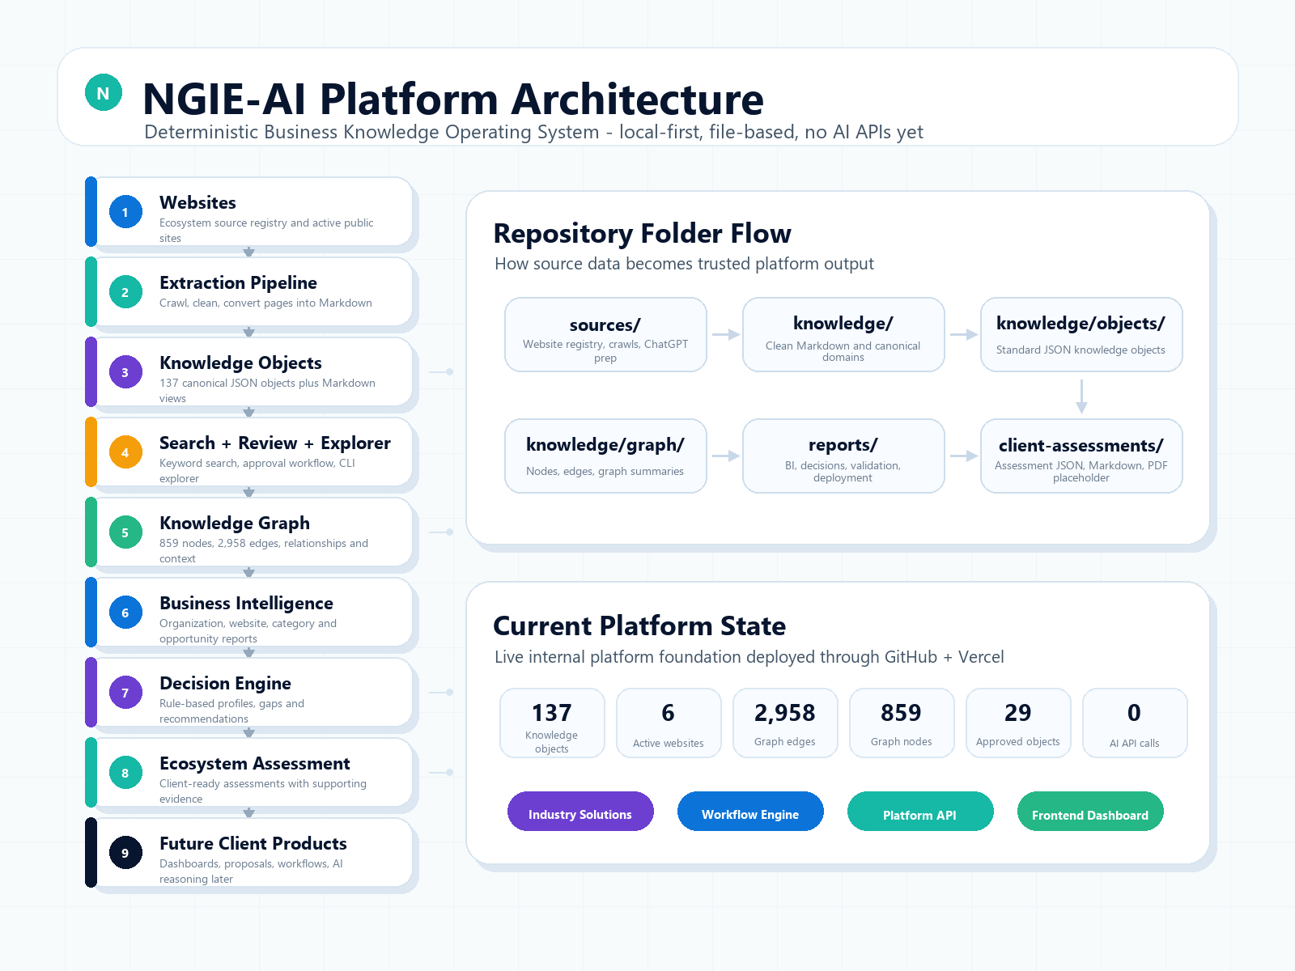
HOW THE SYSTEM WORKS
Public domains become reusable business intelligence
The same knowledge foundation supports search, review, graph relationships, decisioning, assessments, and future client products.

Slide 5
DOMAIN PROMOTION STRATEGY
Each domain becomes a growth channel
Each brand can promote its own offer while supporting one unified platform story.
GiNi Tech
AI, SEO, websites, automation, and platform services
eRiverSpace
Nonprofit innovation, training, workshops, and community programs
Ellijay RiverSpace
Tourism, events, hospitality, and local experience offers
Giniverse108
Marketplace products, ecommerce, and retail pathways
FoodTechSupply
Foodservice supply, operational products, and procurement support
The pitch is not just a website. It is an ecosystem operating layer that connects every domain to client outcomes.

Slide 6
WHAT CLIENTS CAN EXPERIENCE TODAY
A practical growth assessment journey
A prospect can move from basic business inputs to a structured profile, gap analysis, recommendations, and downloadable reports.
1
2
3
4
5
→
→
→
→
Inputs
Score
Gaps
Services
Report
The assessment references supporting knowledge objects
Recommendations are deterministic and reviewable
Reports can be used in sales conversations, proposals, and onboarding

Slide 7
CLIENT EXAMPLE
El Rey Cantina turns assessment into a sales conversation
The assessment surfaces strengths, critical gaps, and evidence-backed next steps for a local business scenario.
Training
CRITICAL
42/100
Workforce
CRITICAL
Overall capability score
Operations
HIGH
Strongest declared areas: Digital Presence, Technology, Marketing
Sales
HIGH
AI readiness
HIGH
This is the bridge from platform proof to a concrete service package: training, customer follow-up, reporting, and AI-readiness workflows.

Slide 8
SERVICE PACKAGING
NGIE-AI turns capabilities into sellable platform services
The architecture supports clear offers that can be promoted across domains and tailored by industry.
Growth Assessment
Website + SEO System
AI Readiness Package
Client intake, capability score, gap analysis, 90-day roadmap
Domain optimization, content structure, service pages, local visibility
Workflow mapping, FAQ automation planning, training priorities
Marketplace Enablement
Training + Operations
Client Workspace
Product pathways, partner recommendations, commerce opportunities
SOPs, workshops, playbooks, staff enablement, reporting rhythm
Reports, proposals, project plans, and delivery artifacts

Slide 9
GO-TO-MARKET MOTION
Assessments turn trust into service delivery
The platform creates a repeatable path from domain visitor to qualified prospect to client engagement.
1
2
3
4
5
Promote
Assess
Recommend
Package
Grow
Drive traffic from ecosystem domains and local campaigns
Invite businesses to complete the growth assessment
Show gaps, services, products, training, and partners
Turn the roadmap into a proposal and delivery plan
Use reports and workspaces to manage the relationship
The assessment is the conversion moment: it makes the problem visible and the next step easy to buy.

Slide 10
The next client conversation can start with an assessment
Use NGIE-AI to promote the ecosystem domains, qualify local businesses, recommend the right services, and turn knowledge into client-ready delivery assets.
Suggested call to action
Book a platform demo and run one sample assessment for your business.
Growth assessments
Platform services
Industry solutions

